Slide 1
Lecture 10
Alkenes and alkynes
cis-, trans-isomerism for alkenes
Nomenclature for alkenes and alkynes

Slide 2
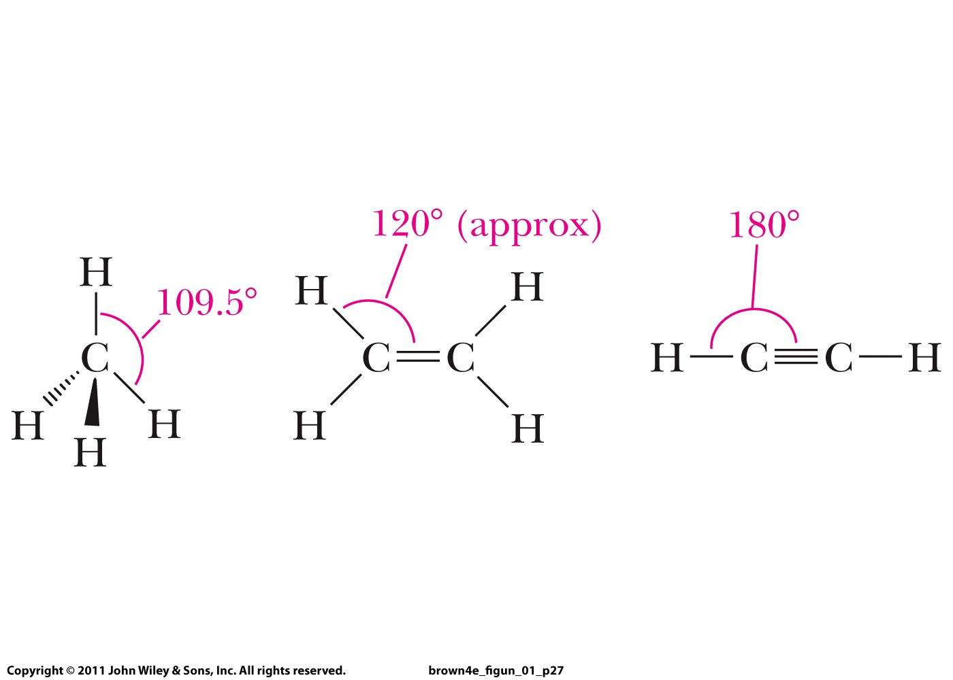
Tetrahedral Trigonal planar Linear
alkane alkene alkyne

Slide 3
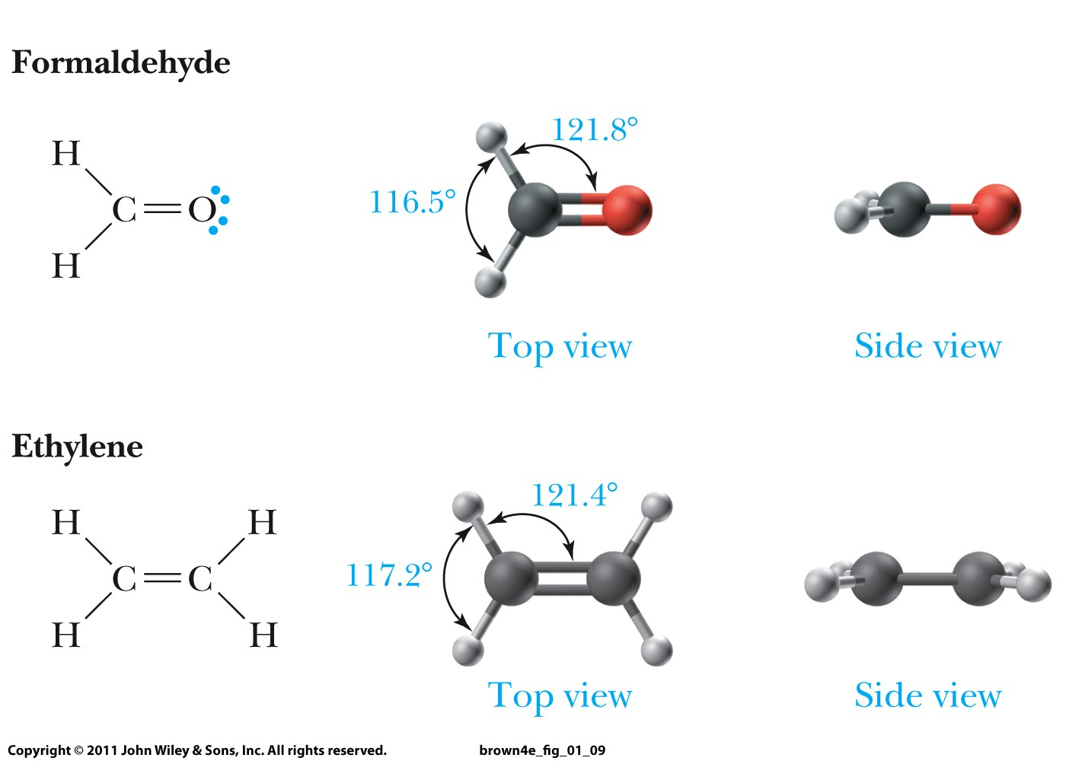
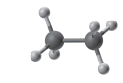
Alkanes
Alkenes

Slide 4
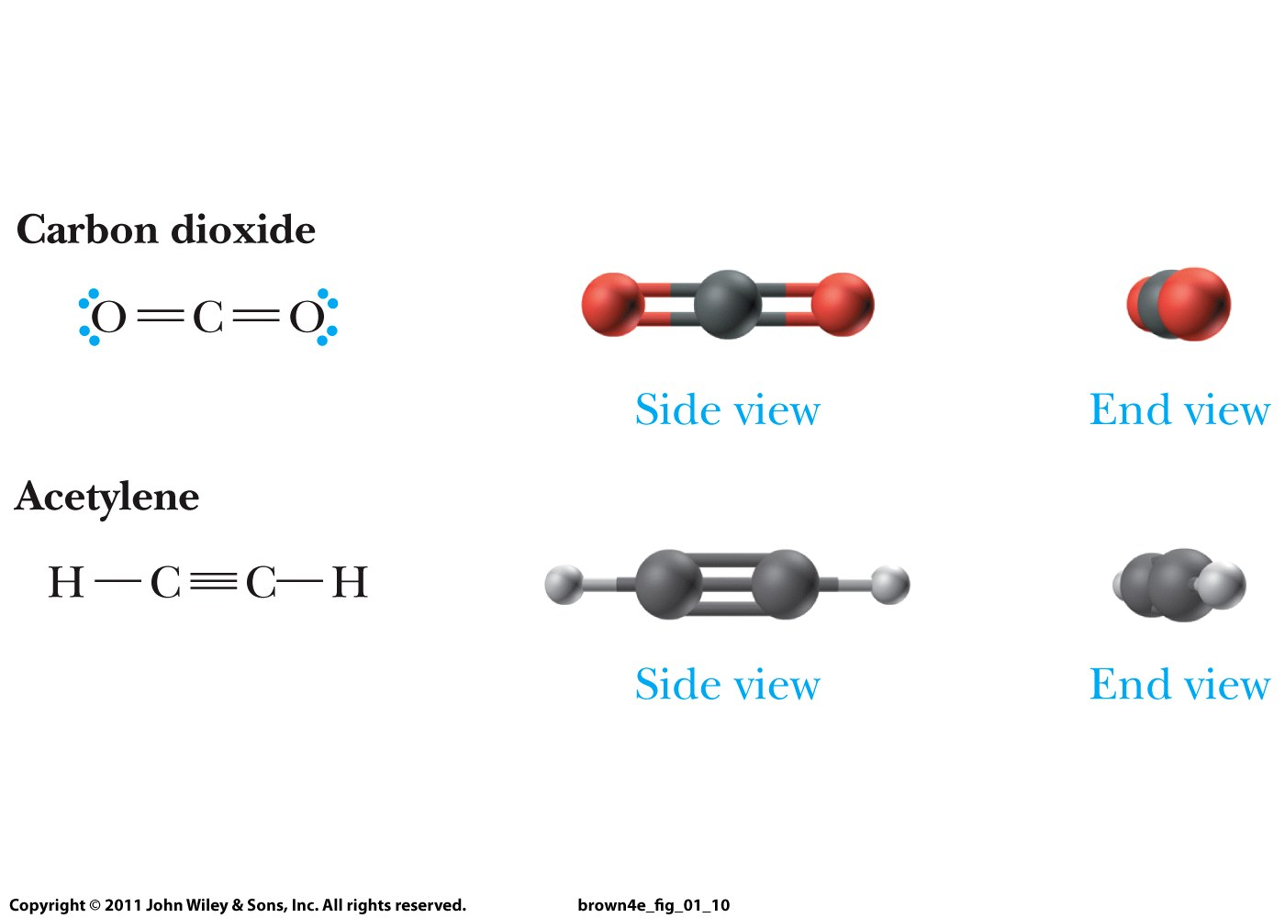

Alkynes

Slide 5
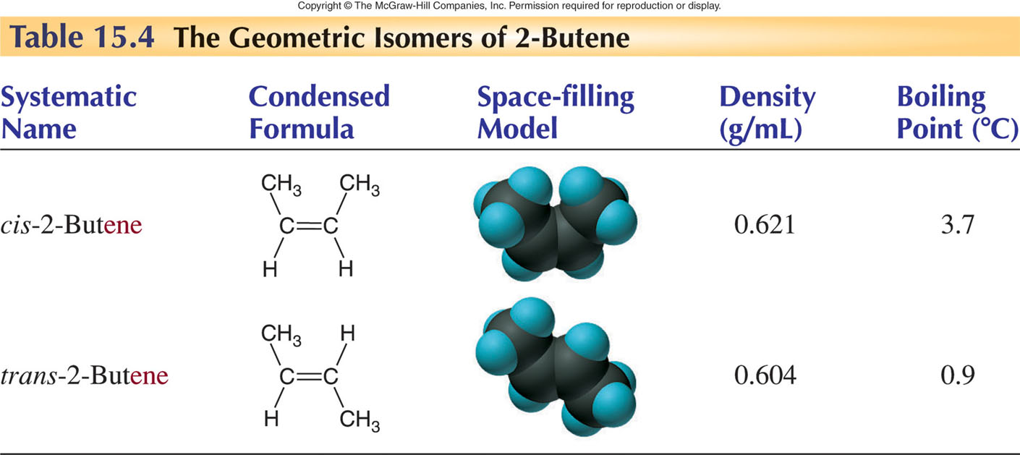
Cis-, trans-isomers of alkenes
Rotation cannot occur about a C=C bond!
Which isomer is more stable?

Slide 6
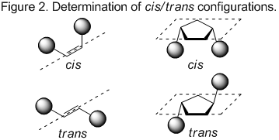

Slide 7
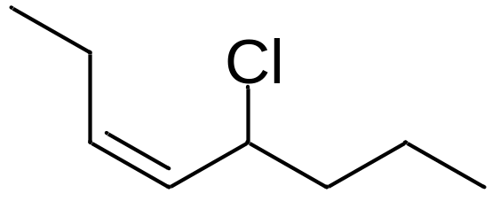
Nomenclature for alkenes and alkynes:
Same as earlier except that
Use an infix that shows whether the compound contains
C=C or C≡C bonds: instead of ane, use ene or yne
Number the parent chain so that the first carbon of C=C or C≡C bond gets the smallest possible number and the second carbon the second lowest number
Parent chain must contain both unsaturated carbons; if there are options, choose the most substituted chain
You must use cis- or trans-prefix if cis-, trans-isomerism is involved
cis-4-chloro-3-heptene

Slide 8
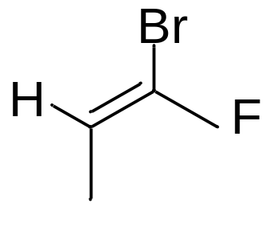
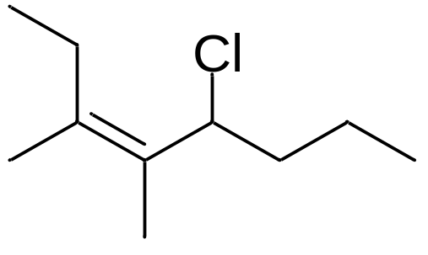
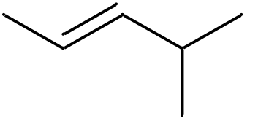
Priority rules for E, Z – nomenclature
when C=C carries three or four substituents
Rule 1: Examine atoms directly attached to each of the carbons in C=C.
A substituent with a higher atomic number takes priority
Rule 2: If there are substituents with an equal rank,
proceed to the next substituents until you find the first point of difference.
The chain with the substituent of a higher atomic number takes priority
Assign Z (= zusammen) to C=C with high priority atoms on the same
Side of C=C but E (= entgegen) if they are on opposite sides

Slide 9
